Slide 1




Browser Automation with Python
Miguel A. Tannous G.
Software Developer | Drums
miguel.tannous@reponic.org
@reponic_drums

Slide 2


Software Development.
Web Development.
Social Media Marketing.
Graphic Design.
@reponic_tech
https://www.reponic.org/

Slide 3
Why?
Easy and Fun.
Save Time.
One time effort.

Slide 4
What we are going to use:
Python.
Selenium.
Tkinter.
Browser.

Slide 5


Selenium (Automating Browsers)
Testing web apps.
Automating tasks.
Tkinter.
Dynamically rendered content

Slide 6
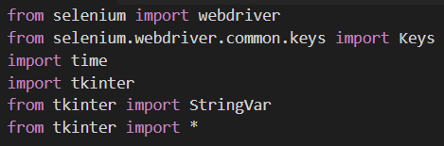
Imports:

Slide 7
Tkinter elements:
Entry
Window
Text Variable
Insert (Function)
Index
Text
Button
Window
Text
Command (Function)

Slide 8
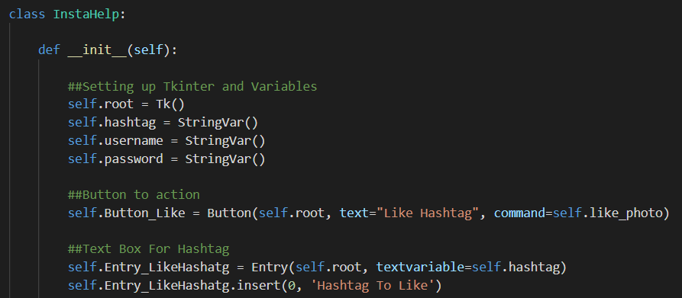
Init Function (Part 1):

Slide 9
Tkinter elements:
Grid
Row
Column
Columnspan (Take the width of a certain # of columns)
Pack
Window that was defined before.
Side (LEFT, RIGHT, BOTTOM, TOP)

Slide 10
Selenium Webdriver:
Browsers
Chrome
Firefox
IE
Safari
Opera
Options:
setHttpProxy
Add Argument
User Agent
addExtension

Slide 11
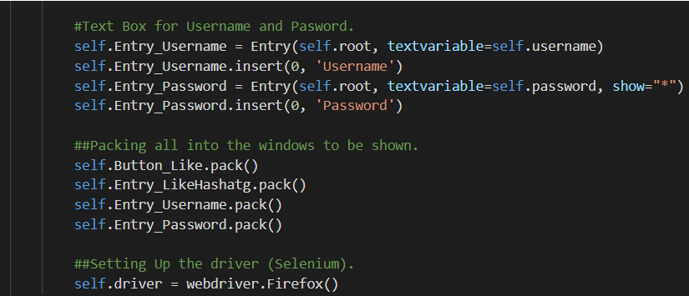
Init Function (Part 2):

Slide 12
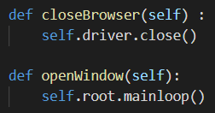
Opening and Closing:

Slide 13
Webdriver Locating Elements:
(Single Element) find_element_by_
id
name
xpath
link_text
partial_link_text
tag_name
class_name
css_selector

Slide 14
Webdriver Locating Elements:
(Multiple Elements, These will return a list) find_elements_by_
name
xpath
link_text
partial_link_text
tag_name
class_name
css_selector

Slide 15
Things to do with the elements:
Filling in forms.
Drag and drop.
Moving between windows and frames
Handle Popup dialogs.
Navigation: History and Location.
Cookies (Add and Get).

Slide 16
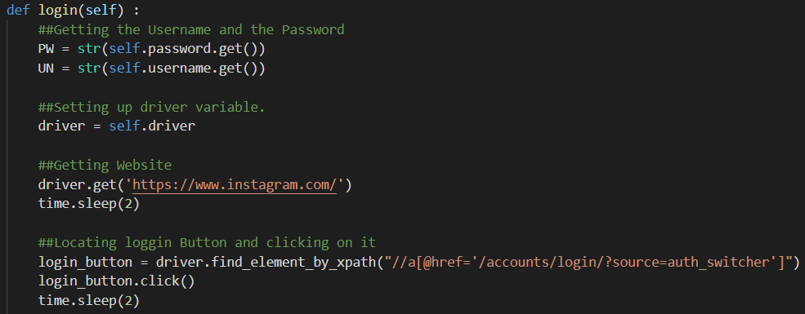
Login (Part 1):

Slide 17
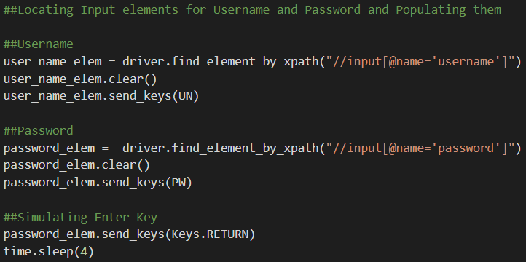
Login (Part 2):

Slide 18
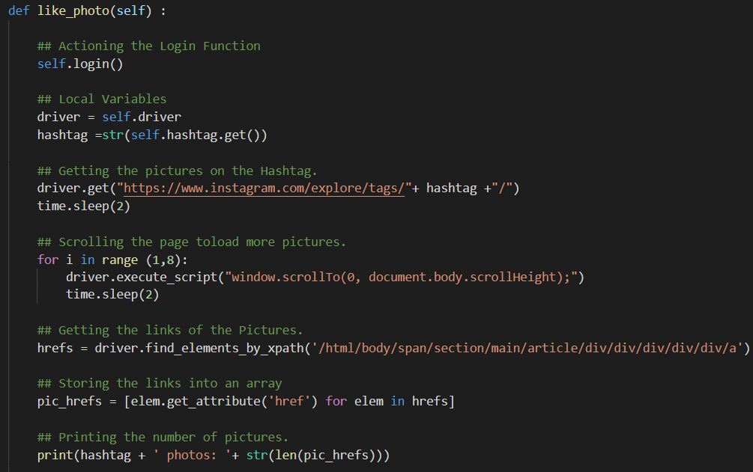
Finding and Liking (Part 1):

Slide 19
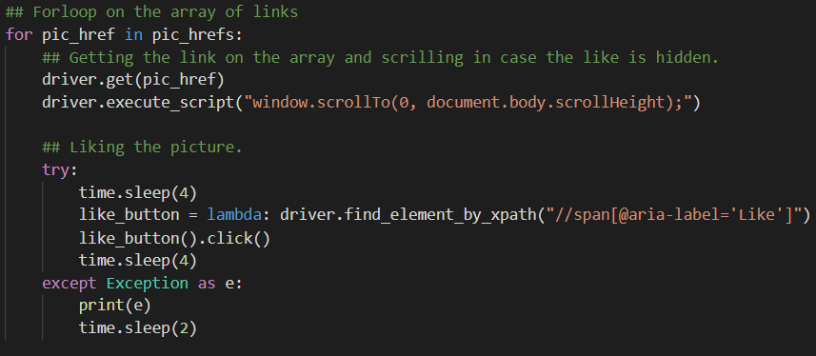
Finding and Liking (Part 2):

Slide 20

Most important thing:

